Slide 1
Introduction to Trees
Tree data structure is a hierarchical structure that is used to represent and organize data in a way that is easy to navigate and search.
It is a collection of nodes that are connected by edges and has a hierarchical relationship between the nodes.
The topmost node of the tree is called the root, and the nodes below it are called the child nodes.
Each node can have multiple child nodes, and these child nodes can also have their own child nodes, forming a recursive structure.

Slide 2
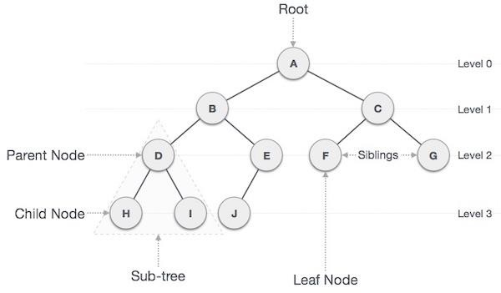
Tree Structure

Slide 3
Why Tree a Non Linear Data Strucutre
The data in a tree are not stored in a sequential manner i.e., they are not stored linearly.
Instead, they are arranged on multiple levels or we can say it is a hierarchical structure.
For this reason, the tree is considered to be a non-linear data structure.

Slide 4
Terminologies of Tree Data Structure
Parent Node: The node which is a predecessor of a node is called the parent node of that node. {B} is the parent node of {D, E}.
Child Node: The node which is the immediate successor of a node is called the child node of that node. Examples: {D, E} are the child nodes of {B}.
Root Node: The topmost node of a tree or the node which does not have any parent node is called the root node. {A} is the root node of the tree. A non-empty tree must contain exactly one root node and exactly one path from the root to all other nodes of the tree.
Leaf Node or External Node: The nodes which do not have any child nodes are called leaf nodes. {K, L, M, N, O, P, G} are the leaf nodes of the tree.
Ancestor of a Node: Any predecessor nodes on the path of the root to that node are called Ancestors of that node. {A,B} are the ancestor nodes of the node {E}

Slide 5
Terminologies of Tree Data Structure
Descendant: A node x is a descendant of another node y if and only if y is an ancestor of x.
Sibling: Children of the same parent node are called siblings. {D,E} are called siblings.
Level of a node: The count of edges on the path from the root node to that node. The root node has level 0.
Internal node: A node with at least one child is called Internal Node.
Neighbour of a Node: Parent or child nodes of that node are called neighbors of that node.
Subtree: Any node of the tree along with its descendant.

Slide 6
Representation of Tree Structure
struct Node {
int data;
struct Node* first_child;
struct Node* second_child;
struct Node* third_child;
.
.
.
struct Node* nth_child;
};

Slide 7
Importance of Trees
One reason to use trees might be because you want to store information that naturally forms a hierarchy.
Trees (with some ordering e.g., BST) provide moderate access/search (quicker than Linked List and slower than arrays).
Trees provide moderate insertion/deletion (quicker than Arrays and slower than Unordered Linked Lists).
Like Linked Lists and unlike Arrays, Trees don’t have an upper limit on the number of nodes as nodes are linked using pointers.

Slide 8
Types of Tree Data Structures
Tree data structure can be classified into three types based upon the number of children each node of the tree can have. The types are:
Binary tree: In a binary tree, each node can have a maximum of two children linked to it.
Some common types of binary trees include full binary trees, complete binary trees, balanced binary trees, and degenerate or pathological binary trees.
Ternary Tree: A Ternary Tree is a tree data structure in which each node has at most three child nodes, usually distinguished as “left”, “mid” and “right”.
N-ary Tree or Generic Tree: Generic trees are a collection of nodes where each node is a data structure that consists of records and a list of references to its children(duplicate references are not allowed).
Unlike the linked list, each node stores the address of multiple nodes.

Slide 9
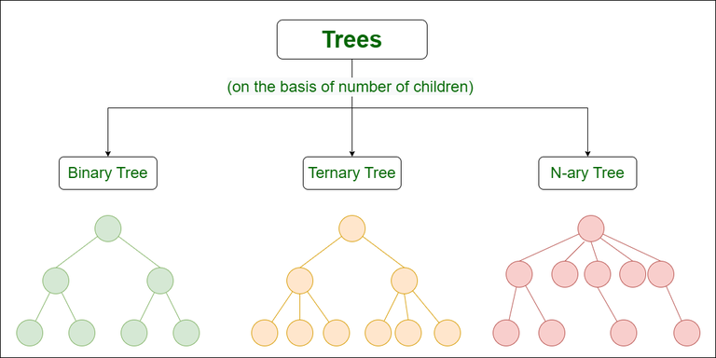
Types of Tree Data Structures

Slide 10
Binary Search Tree
A Binary Search Tree is a data structure used for organizing and storing data in a sorted manner.
Each node in a Binary Search Tree has at most two children, a left child and a right child, with the left child containing values less than the parent node and the right child containing values greater than the parent node.
This hierarchical structure allows for efficient searching, insertion, and deletion operations on the data stored in the tree.

Slide 11
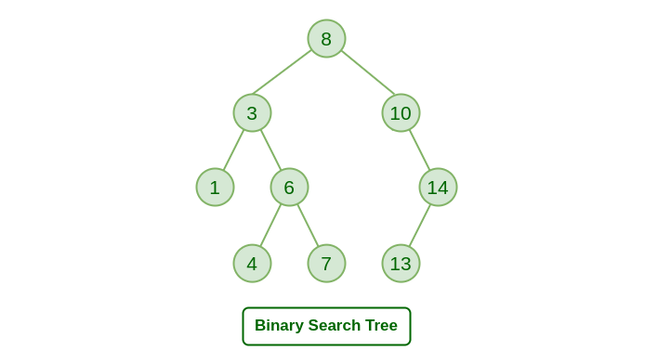
Binary Search Tree

Slide 12
Properties of Binary Search Tree
The left subtree of a node contains only nodes with keys lesser than the node’s key.
The right subtree of a node contains only nodes with keys greater than the node’s key.
This means everything to the left of the root is less than the value of the root and everything to the right of the root is greater than the value of the root.
Due to this performing, a binary search is very easy.
The left and right subtree each must also be a binary search tree.
There must be no duplicate nodes(BST may have duplicate values with different handling approaches)

Slide 13
Operations on Binary Search Tree
Insertion
Deletion
Search
Traversal

Slide 14
Insert in Binary Search Tree
A new key is always inserted at the leaf.
Start searching a key from the root till a leaf node.
If the new key is less than the current key node then traverse left sub tree to reach the leaf node
If the new key is greater than the current key node then traverse right sub tree to reach the leaf node
Repeat the above 2 steps until you reach the leaf node
Once a leaf node is found, the new node is added as a child of the leaf node.

Slide 15
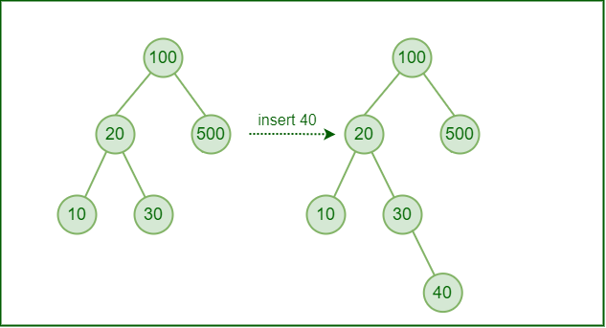
Insertion in BST

Slide 16
Code to insert in BST
Code to create new node:
struct node* newNode(int item)
{
struct node* temp
= (struct node*)malloc(sizeof(struct node));
temp->key = item;
temp->left = temp->right = NULL;
return temp;
}
Structure code:
struct node {
int key;
struct node *left, *right;
};

Slide 17
Code to insert in BST
struct node* insert(struct node* node, int key)
{
if (node == NULL)
return newNode(key);
if (key < node->key)
node->left = insert(node->left, key);
else if (key > node->key)
node->right = insert(node->right, key);
return node;
}

Slide 18
Searching in BST
We compare the value to be searched with the value of the root.
If it’s equal we are done with the search if it’s smaller we know that we need to go to the left subtree because in a binary search tree all the elements in the left subtree are smaller and all the elements in the right subtree are larger.
Repeat the above step till no more traversal is possible
If at any iteration, key is found, return True. Else False.

Slide 19
Code for Searching in BST
struct node* search(struct node* root, int key)
{
if (root == NULL || root->key == key)
return root;
if (root->key > key)
return search(root->left, key);
return search(root->right, key);
}

Slide 20
Deletion in BST
Search for the node to be deleted by using search technique
If the node to be deleted has no children, simply delete it.
If the node to be deleted has one child, make the child of the node to be deleted the new parent of the node's parent.
If the node to be deleted has two children, find the inorder successor of the node.: The inorder successor is the smallest node in the right subtree of the node to be deleted. Replace the value of the node to be deleted with the value of the inorder successor. Then, delete the inorder successor.

